Slide 1
Channels
Brandon Minnick
Code Traveler, LLC
Notes:
Welcome to the last section of Day 2. Everything up to now has been about doing more work at the same time. Channels are about something different. They connect two pieces of code that run at different speeds, so that neither one has to know anything about the other. One side produces items, the other side consumes them, and the channel sits in the middle and absorbs the difference. You already know the two ingredients. A channel is a thread safe queue, like the concurrent collections we just covered, plus the asynchronous waiting you learned on Day 1. Put those together and you get a queue you can await. The app in this section is a device telemetry webhook that does its slow work in exactly the wrong place, and almost all of the fix lives in one file. Overview of the API: https://learn.microsoft.com/dotnet/core/extensions/channels

Slide 2
Producer / Consumer Model
System.Threading.Channels
FIFO
  First-In First-Out (Queue)
Buffering
  The channel absorbs speed differences between production and consumption rates
Thread Safe, Async-First, High Performance
Notes:
A channel is the producer and consumer model with a first class API. FIFO means the consumer sees items in the order they were written, which matters a great deal when the items are events. Buffering is the reason the pattern exists at all. The producer and the consumer almost never run at the same speed, and the buffer absorbs that difference so neither side has to run on the other side's schedule. Thread safe means many threads can write and many threads can read with no lock that you wrote. Async first means the waiting is done with await, so a consumer with nothing to do costs you no thread at all, and a producer that has to wait for room does it without blocking. High performance means the implementation is tuned for this one job, including allocation free reads on the fast path. If you have used BlockingCollection, this is the version that does not block. https://learn.microsoft.com/dotnet/core/extensions/channels

Slide 3
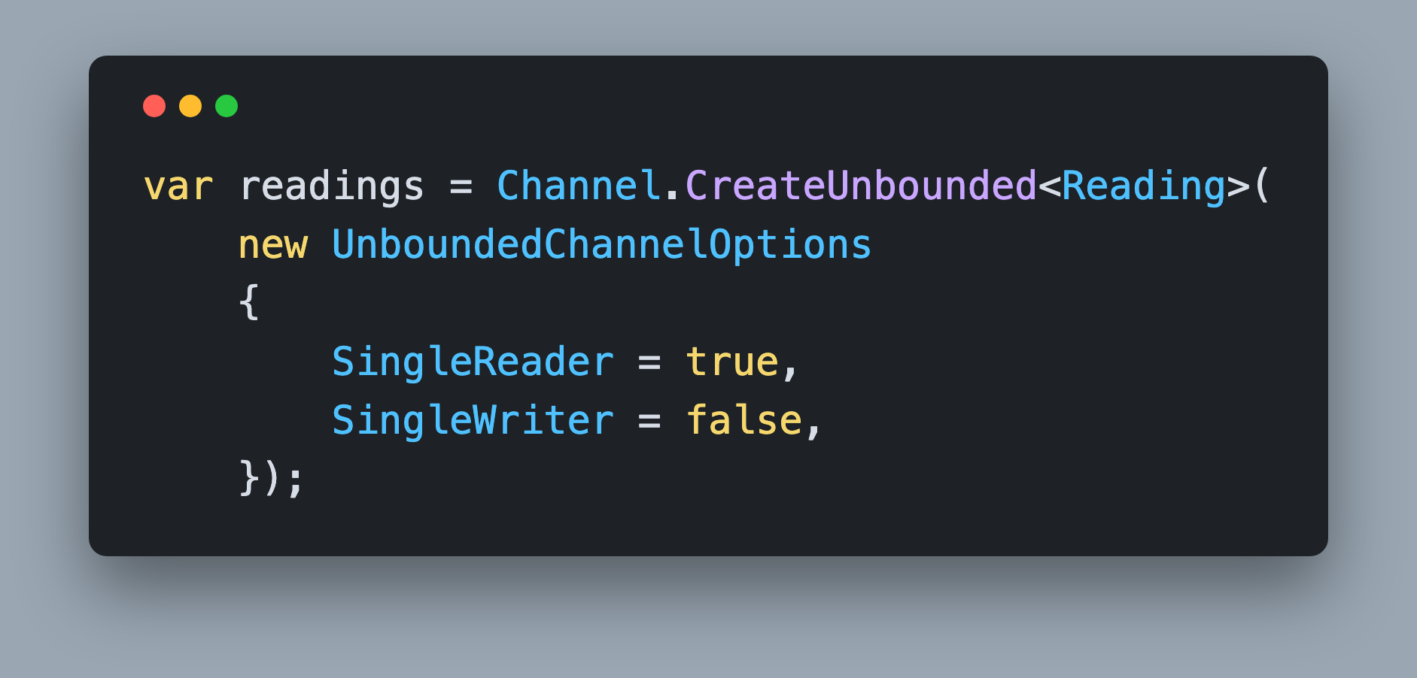
Creating Unbounded Channels
Channel.CreateUnbounded<T>()
Creates a Channel with an unlimited buffer
    Still limited by hardware resources
Notes:
The static Channel class is a factory. CreateUnbounded gives you a channel whose buffer grows as far as memory allows, which means a write never waits, and never fails as long as the writer is still open. Once Complete has been called, even an unbounded write fails, and we come back to that in a few slides. Unlimited is the right choice when you know the producer cannot outrun the consumer for long, or when dropping an item is worse than any amount of memory. It is the wrong choice when an upstream burst can outpace you indefinitely, because then unlimited really means until the process dies. UnboundedChannelOptions adds nothing of its own. SingleReader, SingleWriter and AllowSynchronousContinuations all live on the shared ChannelOptions base type, so the bounded options carry them too. Capacity and FullMode are what the bounded type adds. .NET 9 added CreateUnboundedPrioritized, which orders items by a comparer instead of first in first out. The parameterless overload uses Comparer<T>.Default and throws at runtime if T does not implement IComparable<T>. Pass UnboundedPrioritizedChannelOptions<T> with your own Comparer for any other order. https://learn.microsoft.com/dotnet/api/system.threading.channels.channel

Slide 4
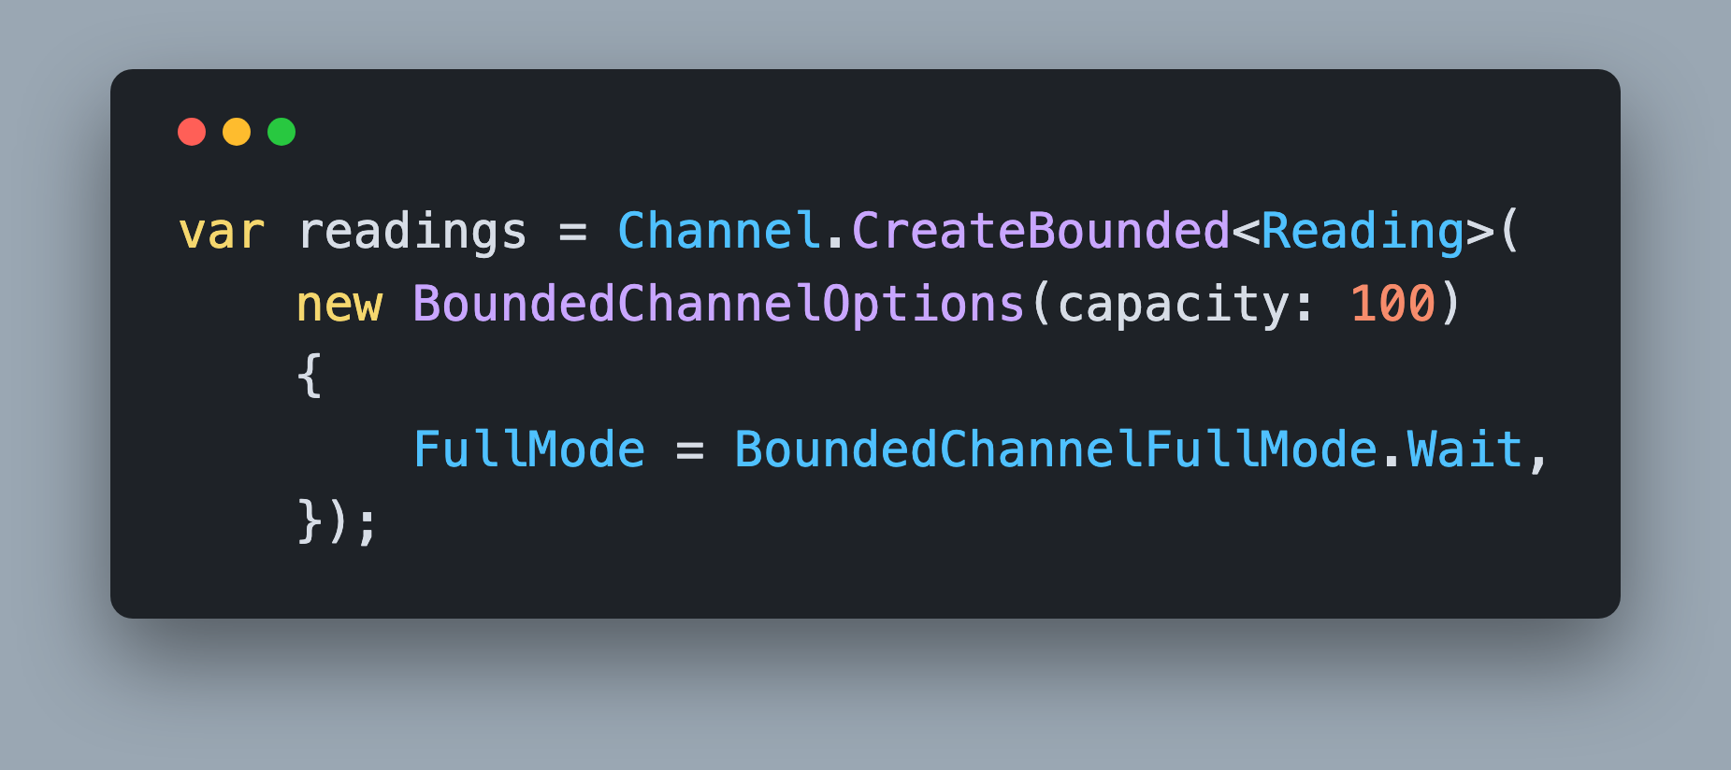
Creating Bounded Channels
Channel.CreateBounded<T>()
Creates a Channel with a limited buffer
Capacity is the backpressure knob
`FullMode` decides what a full channel does to a write
Notes:
A bounded channel takes its capacity in the BoundedChannelOptions constructor, and that number is a design decision rather than a tuning detail. Capacity is how far behind you are willing to let the consumer fall before the producer has to feel it. Pick it from something real: how much work you can afford to lose in a crash, how much memory a queued item costs, or how long a caller will tolerate waiting. A capacity of 100 with a consumer that handles 25 items per second means you are accepting up to four seconds of lag. FullMode is the second half of the decision and it decides what happens on the write that does not fit. Wait is the only mode that ever slows the producer down. The other three keep the producer at full speed by throwing an item away. https://learn.microsoft.com/dotnet/api/system.threading.channels.boundedchanneloptions

Slide 5
Handling Backpressure
BoundedChannelFullMode
BoundedChannelFullMode.Wait
  Wait for space, then complete the write
BoundedChannelFullMode.DropNewest
  Remove the newest item to make room
BoundedChannelFullMode.DropOldest
  Remove the oldest item to make room
BoundedChannelFullMode.DropWrite
  Drop the item being written
Notes:
Backpressure is what a full queue does to the code filling it. Wait makes WriteAsync suspend until a consumer frees a slot, which throttles the producer to the speed of the consumer without a single line of rate limiting code. The three drop modes keep every write fast by discarding something instead. DropOldest keeps the freshest data, which is what you want for a live gauge where only the latest reading matters. DropNewest keeps the earliest data. DropWrite discards the item you are writing right now, which is the cheapest and the easiest to reason about. Under the drop modes the write reports success, so by default nothing tells you data disappeared. If you need to know, use the CreateBounded overload that takes an itemDropped callback, added in .NET 6. It runs for every item the channel discards, on the writing thread, so keep it cheap. Increment a counter, do not log inline. And note that under DropOldest and DropNewest the item you lose is one already in the queue, not the one you just wrote, which is why you cannot count drops yourself at the call site. https://learn.microsoft.com/dotnet/api/system.threading.channels.boundedchannelfullmode

Slide 6
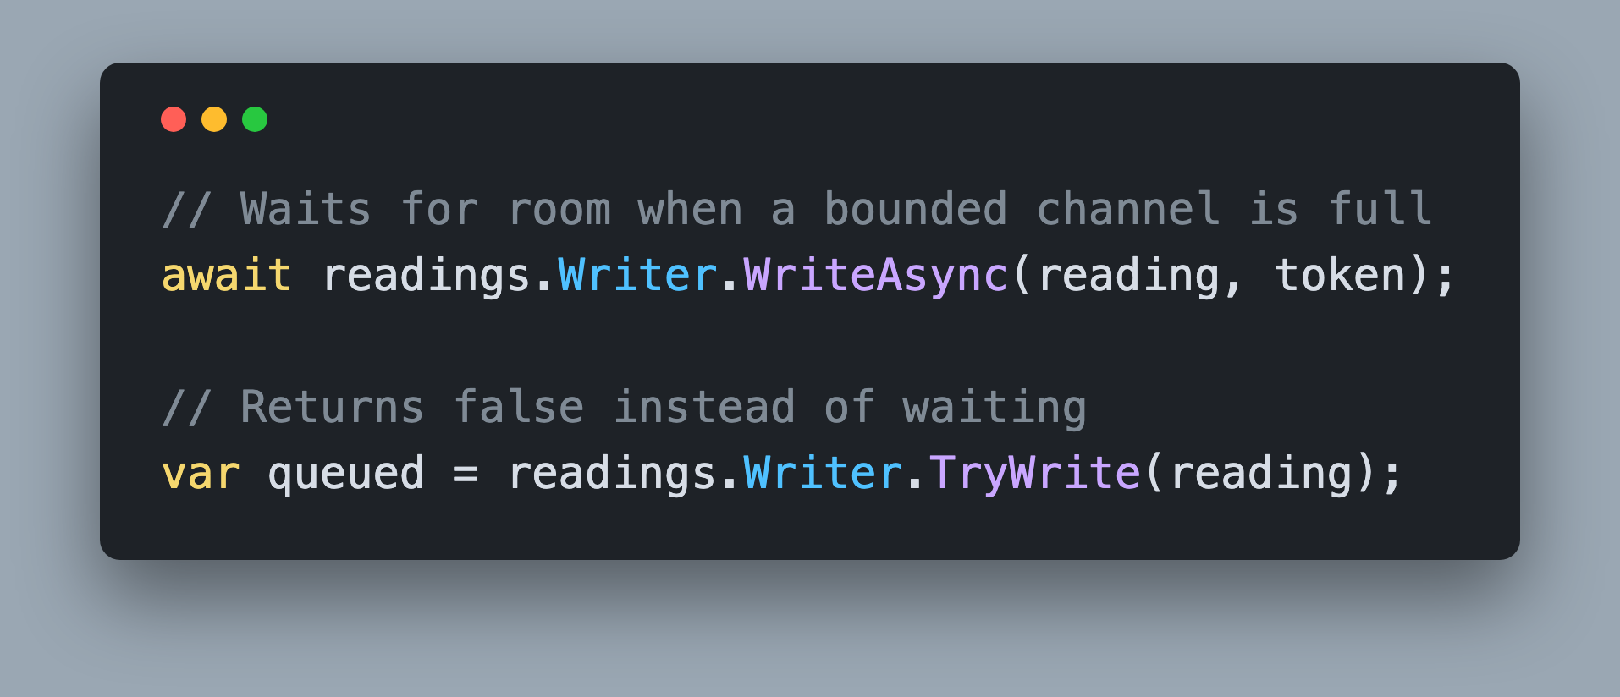
Writing to a Channel
ChannelWriter<T>
`WriteAsync()`
  Returns a `ValueTask`
  Usually completed
`TryWrite()` never waits
Notes:
WriteAsync is the call you will use most. It returns a ValueTask and on an unbounded channel, or a bounded channel with room, that ValueTask is already completed and allocates nothing. It only suspends when the channel is full and FullMode is Wait, which is the moment backpressure becomes real in your code. Pass your CancellationToken so a shutdown does not leave a producer parked forever. TryWrite is the non waiting version. It returns false when a bounded channel is full under Wait, and it lets you decide what to do about that yourself, including logging a drop your team can alert on. There is also WaitToWriteAsync for the case where you want to know that room exists before you go build the item. Once the writer is completed, WriteAsync throws ChannelClosedException, while TryWrite and WaitToWriteAsync return false, so a producer that uses TryWrite has to check the result on the way down. https://learn.microsoft.com/dotnet/api/system.threading.channels.channelwriter-1

Slide 7
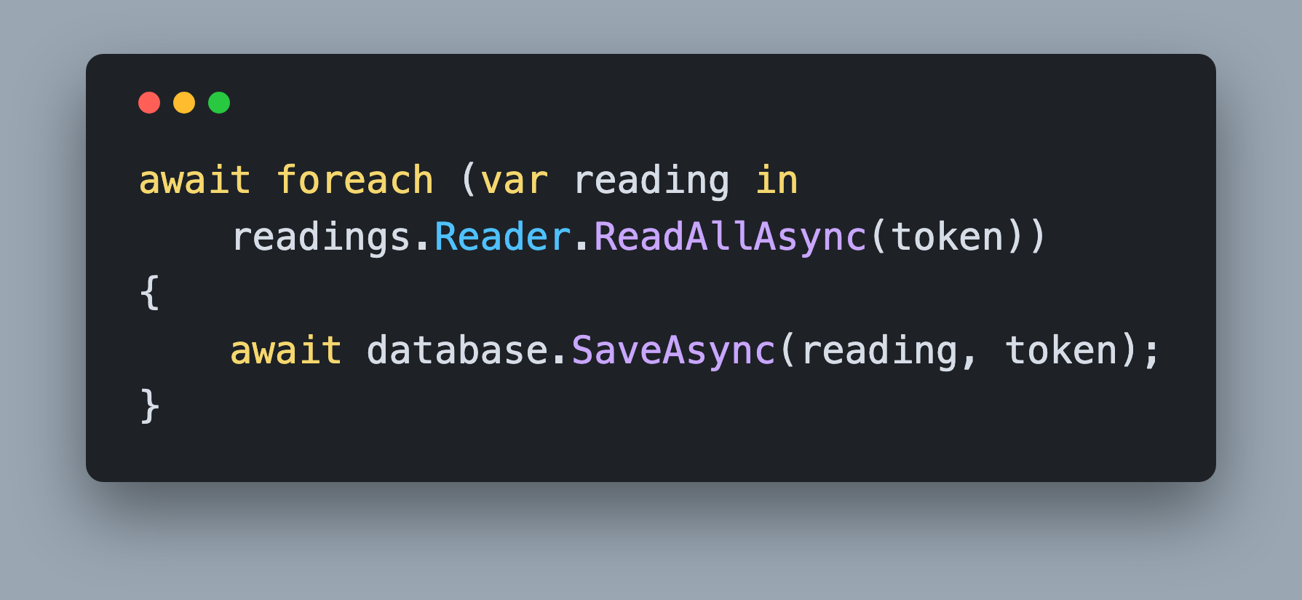
Reading from a Channel
ChannelReader<T>.ReadAllAsync()
Returns an `IAsyncEnumerable<T>`
An idle consumer holds no thread
    Each item is delivered to exactly one reader
Notes:
This loop is the whole consumer. ReadAllAsync returns an IAsyncEnumerable, so an await foreach yields every item that was ever written, in order, and suspends when the channel is empty. That suspension is why a channel consumer needs no busy wait. Waiting for the next item is now an await, not a sleep, so an idle consumer costs you nothing but a state machine sitting in memory. The loop ends on its own once the writer is completed and the buffer is drained, which is how a well behaved pipeline shuts down. Underneath, ReadAsync, TryRead, and WaitToReadAsync are still available if you need finer control, and ReadAllAsync is written in terms of them. One more property to know: Reader.Count is the current buffered depth, and it is the single best number to put on a dashboard, because it tells you which half of your pipeline is losing. https://learn.microsoft.com/dotnet/api/system.threading.channels.channelreader-1

Slide 8
Cleaning Up
Writer.Complete()
Always call `Writer.Complete()`
  Marks the channel as complete
  Nothing more can be written
  Allows `Reader.ReadAllAsync()` to finish once the channel is empty
Alternatively, `Writer.TryComplete()`
  Returns `false` when the channel has already been completed
Notes:
This is the step everyone forgets, and forgetting it is the most common channel bug. ReadAllAsync has no way to know that no more items are coming, so without Complete the await foreach waits forever and whatever awaits that consumer task never returns. Complete does two things. It rejects every later write, with WriteAsync throwing ChannelClosedException while TryWrite and WaitToWriteAsync simply return false, and it lets the reader finish once the buffer has drained, so any backlog still gets processed before the loop ends. You can pass an exception to Complete to tell consumers that the producer failed rather than finished. Use TryComplete when more than one code path might close the channel, because it returns false instead of throwing on a second call. There is also a Reader.Completion task you can await if you want to know the moment the last item has been consumed. https://learn.microsoft.com/dotnet/api/system.threading.channels.channelwriter-1.complete

Slide 9
Channel or ConcurrentQueue?
Storage vs Coordination
`ConcurrentQueue<T>`
  Thread safe storage
  `TryDequeue()` answers immediately
  You still write the waiting loop yourself
`Channel<T>`
  Storage plus asynchronous waiting, capacity, completion
    An unbounded Channel stores its items in a `ConcurrentQueue<T>`
Notes:
You just spent a section on the concurrent collections, so this question always comes up in the room. ConcurrentQueue is storage. It is thread safe, it is fast, and TryDequeue answers immediately with whatever is there right now. What it cannot do is wait. If the queue is empty and the next item has not arrived yet, you have to write the waiting yourself, and that is exactly how people end up with a polling loop that sleeps and checks again, like the one in this section's starter app. A channel is storage plus coordination. You get the same thread safe queue, and you also get an asynchronous wait for the next item, a capacity with a policy for what a full buffer does, and a completion signal that ends the consumer loop. Underneath, an unbounded channel keeps its items in a ConcurrentQueue, so this is not a performance tradeoff. Reach for a concurrent collection when you need shared storage, and for a channel when one side hands work to another. https://learn.microsoft.com/dotnet/core/extensions/channels

Slide 10
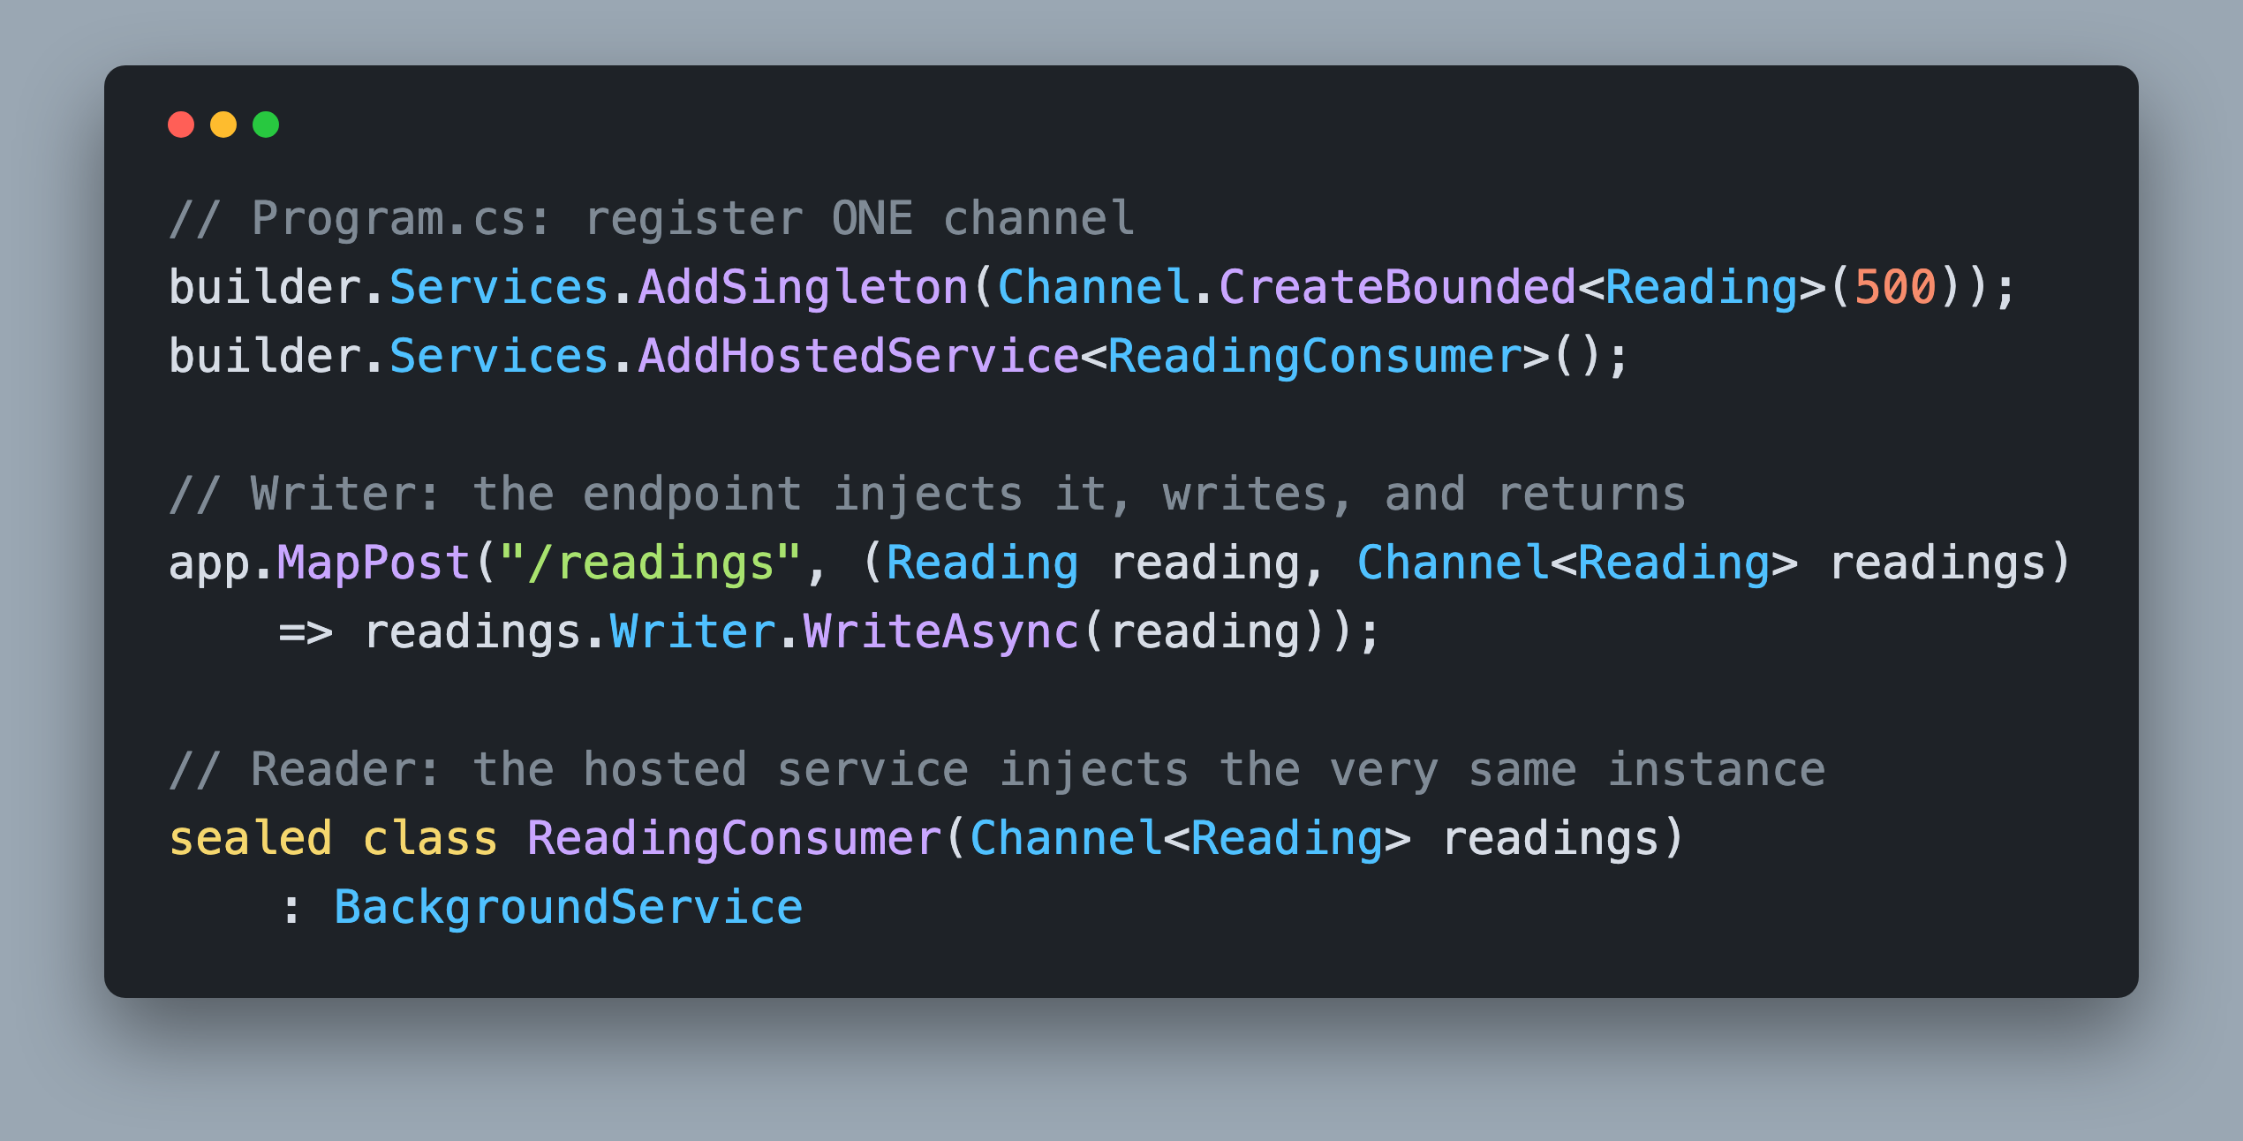
Wiring the Channel
One Instance, Injected Twice
Register the `Channel<T>` once, as a singleton
Writer and Reader both inject that same instance
    One object, two views of it: `.Writer` and `.Reader`
Notes:
This is the question everyone asks first, and the answer is smaller than people expect. A Channel is just an object. The producer and the consumer are only connected because they are holding the same one, and dependency injection is how you arrange that.
Register the channel once with AddSingleton. Now anything that asks for a Channel of Reading gets that one instance, for the life of the app. The endpoint asks for it and writes to it. The hosted service asks for it and reads from it. Neither one knows the other exists, and that is the point: the channel is the only coupling between them.
Notice there is no separate reader object and no separate writer object to wire up. Writer and Reader are two views onto the same channel, so you never hand a writer to a reader or the other way around.
In the sample app the channel is wrapped in a singleton service instead of being registered bare. Same idea, nicer API: both sides inject that service rather than the channel itself.
https://learn.microsoft.com/dotnet/core/extensions/dependency-injection

Slide 11
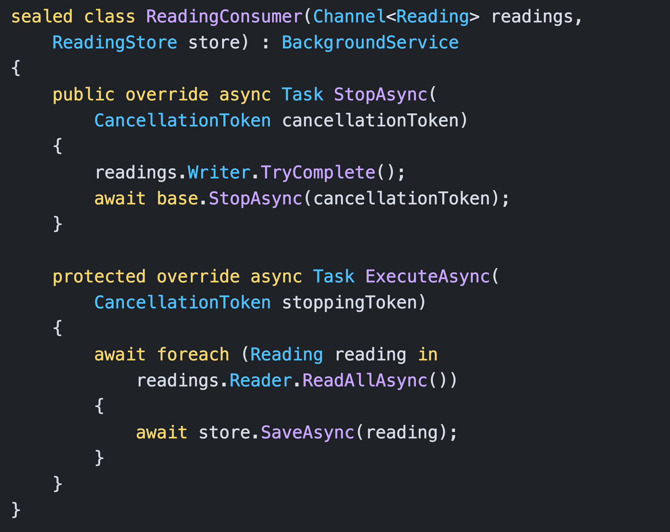
Hosting the Consumer
Microsoft.Extensions.Hosting
One home for a reader, for the life of the app
Cancelling `ReadAllAsync()` abandons the backlog
    Complete the writer in `StopAsync()` to drain the backlog
Notes:
A channel consumer needs somewhere to live that is not a request. In ASP.NET Core that place is a BackgroundService registered with AddHostedService. The host starts ExecuteAsync when the app starts and hands you a stoppingToken that is cancelled when the app is shutting down. Forwarding that token into ReadAllAsync is the obvious version, and it does unwind the loop on shutdown, but cancelling the read loop throws away every item still waiting in the channel. When every item has to be processed, override StopAsync instead: complete the writer there, then call base.StopAsync, which cancels the token and waits for ExecuteAsync to return, bounded by the host's shutdown timeout. ReadAllAsync hands out what is still buffered and then ends on its own, so the backlog is finished before the app exits. Two more things to keep in mind. A BackgroundService is a singleton, so if you need a scoped service such as a database context, create a scope per item inside the loop. And an unhandled exception escaping ExecuteAsync stops the host by default, which is usually what you want, but it means the body of your loop needs its own try and catch if one poison item should not take the app down. https://learn.microsoft.com/aspnet/core/fundamentals/host/hosted-services

Slide 12
Challenge: Drain the Pipeline
20 Minutes
Replace the `List<T>` with a bounded `Channel<TelemetryEvent>`
Accept, queue, return
Move the database write into the consumer
Run several consumers under the `BackgroundService`
Delete the polling loop and its `Task.Delay`, then drain the backlog on shutdown
    *AI Agents are for understanding, not for solving
Notes:
Open the Start folder, run TelemetryPipeline on port 5013, and click Receive 400 events. Watch the average accept sit above 41 milliseconds while the endpoint takes more than 16 seconds to swallow the burst. Almost everything you need to change is in Services/TelemetryIngestService.cs, the shutdown fix goes in Services/TelemetryProcessor.cs, and each mistake is marked with a ToDo Refactor comment that names the step that checks it. Your job is to make accepting an event mean queueing it, nothing more, and to let the background service do the slow write on its own time. When you are done, the accept path should measure at zero milliseconds, the burst should finish instantly, and the written count should climb to 400 over the next couple of seconds while you press Refresh counters. And if you press Ctrl+C straight after a burst, the app should pause for about two seconds while it writes the backlog, instead of quitting instantly. The workshop guide docked beside the Ingest page walks you through the challenge one step at a time, and the README has the full requirement list and the acceptance checks. Twenty minutes on the clock, then we review approaches together before walking through the solution.

